Slide 1


Data Driven Decision Making
Bachelor Thesis Project
Dr. Deepak Sharma
Dr. S. M. Hazarika
Dept. of Mechanical Engineering, IITG
Nikhil Panse - 160103081
Vrishank Bhardwaj - 160103076

Slide 2
Introduction
Today, Industrial Engineering experts are focusing on solving complex industry problems using data science.
Data Driven Decision Making conventionally comprises of machine learning algorithms modelled on a given data to infer useful characteristics which help in taking decisions.
We aim to combine data-driven machine learning techniques and multi-objective optimization algorithms to help industry managers make efficient decisions.
Our idea was inspired from multi-objective evolutionary optimisation algorithms used in industry problems where there are multiple conflicting objectives to be optimized simultaneously. E.g - Inventory and portfolio management.

Slide 3
Literature Review
 | Reference | Methodology | Remarks
 | “Machine Learning For Global Optimization”, Cassioli, A., Di Lorenzo, D., Locatelli, M. et al. Comput Optim Appl (2012) 51: 279. https://doi.org/10.1007/s10589-010-9330-x | Single Objective Function Support Vector Machines used to reduce the search space of algorithm Numerical optimization made faster by using machine learning. | 30% overall computation costs saved due to faster optimization. No user inputs for decision making.
2 | A. Kusiak, Z. Zhang and M. Li,”Optimization of Wind Turbine Performance With Data-Driven Models” in IEEE Transactions on Sustainable Energy, vol. 1, no. 2, pp. 66-76, July 2010. doi: 10.1109/TSTE.2010.2046919 | Three conflicting objective functions modelled on three separate neural networks. Strength Pareto Evolutionary Algorithm (SPEA) used to solve multi-objective problem with many parameters including the 3 objective functions. | Impact of different parameters on wind turbine performance was studied and it was optimized. This study is very relevant to our project.
3 | Y. Li, S. Zhang, J. Zhang, Y. Yin, W. Xiao and Z. Zhang, "Data-driven Multi-objective Optimization for Burden Surface in Blast Furnace with Feedback Compensation," in IEEE Transactions on Industrial Informatics. doi: 10.1109/TII.2019.2908989 | Kernel Extreme Learning Machine algorithm used to predict certain production indicator of furnace. Two-stage multi-objective optimization strategy (NSGA-II and MOPSO algorithms) is used to optimize the production indicator. Feedback compensation to increase efficiency. | KELM is more suitable than SVM for industry problems. The optimal setting values of burden surface in the BF ironmaking process are determined thus avoiding manual operations.
1

Slide 4
 | Reference | Methodology | Remarks
4 | A.A. Rahat, C. Wang, R.M. Everson, J.E. Fieldsend Data-driven multi-objective optimisation of coal-fired boiler combustion systems Appl Energy, 229 (2018), pp. 446-458 | Non-linear regression with gaussian processes to predict NOx emitted and UBC (efficiency) Multi - objective optimisation algorithm based on probabilistic dominance is used to find best set of parameters to estimate the optimal trade-off between UBC and NOx | Parameters or variables of data used to predict in the regression model are later optimised using MOO. Regression model is not trained by evolutionary optimisation.
5 | Y. Jin and B. Sendhoff, "Pareto-Based Multiobjective Machine Learning: An Overview and Case Studies," in IEEE Transactions on Systems, Man, and Cybernetics, Part C (Applications and Reviews), vol. 38, no. 3, pp. 397-415, May 2008. doi: 10.1109/TSMCC.2008.919172 | Evolutionary multi-objective optimization of neural networks is performed (Algorithm similar to NSGA-II is used) The learning performance (error) and model complexity are used as two conflicting objective functions which are optimised on 3 different datasets (breast cancer, diabetes and iris). Ensemble of learning models is formed. | Optimum complexity of model is found for each dataset. Best ensemble model is formed by choosing networks with low complexity from the Pareto front. In our approach, we don’t use complexity of model as an objective function.
6 | Y. Jin, H. Wang, T. Chugh, D. Guo and K. Miettinen, "Data-Driven Evolutionary Optimization: An Overview and Case Studies," in IEEE Transactions on Evolutionary Computation, vol. 23, no. 3, pp. 442-458, June 2019. doi: 10.1109/TEVC.2018.2869001 | A survey of 4 case studies involving multi-objective optimization problems. In al 4 studies, machine learning models were optimized using evolutionary algorithms like NSGA-II or RVEA. | Applications of MOEAs in machine system design, ventilation systems, blast furnaces and surface science was studied. Extensive research opportunities can be seen in this field.

Slide 5
Methodology
The aim is to solve a data driven industry problem with conflicting objectives and in turn make the process of decision-making easier and more efficient.
We plan to achieve this by solving multi-objective machine learning problems derived from real world industries by using evolutionary genetic algorithms.
Two industry case studies will be performed - Commodity Purchase Optimisation and Algorithmic Trading Portfolio Optimisation.
In each case study, a model ( preferably a Reinforcement Learning Model ) will be optimized by using multi-objective evolutionary algorithms ( NSGA-II or LEAF ) instead of classical gradient methods for multiple fitness functions.
The Pareto Front obtained from the optimisation will help decision-makers select desired tradeoff between objectives and make efficient decisions in the relevant industry.

Slide 6
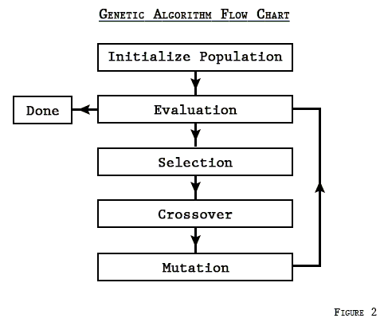
What are genetic algorithms?
Genetic algorithms are computerized search and optimization algorithms based on the mechanics of natural genetics and natural selection.
GAs work with a population of random strings representing design variables. The fitness value of each string is evaluated.
The population is then operated by reproduction, crossover and mutation operators.
The reproduction operator selects good strings and the crossover operator recombines good substrings to make better ones. Mutation operator alters strings to hopefully create better strings.
Until termination condition is reached, the population is iteratively operated by the above operators.
One cycle of these operations is called a ‘generation’.

Slide 7
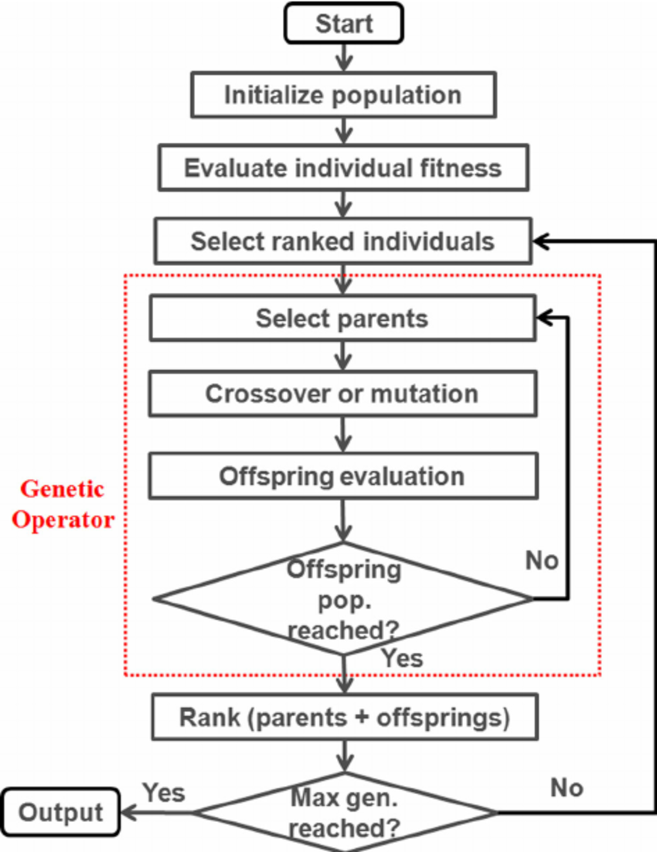
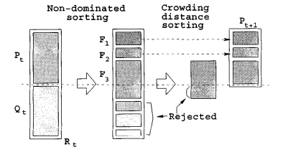
NSGA - II
Non-dominated Sorting Genetic Algorithm is an evolutionary multi-objective optimisation algorithm that has proved to be very successful.
The population of parents and offsprings is sorted into a hierarchy of sub-populations based on the ordering of Pareto dominance (non domination ranks)
If non-dominated ranks are equal, individuals with greater crowding distance are pitched first.
The new population is now used for selection, crossover and mutation operations.
It is a fast nondominated sorting procedure, with an elitist strategy, a parameterless approach and a simple yet efficient constraint-handling method.
Overall complexity is O ( MN^2 )

Slide 8
Case Study - 1
Optimising the purchase of commodities
The operation of most industries require regular purchase of raw material (commodities). By optimally deciding when to purchase these commodities, we can reduce the operational costs in these industries.
We evaluate our methods on a time series dataset of two commodities (Coal and Crude Oil) over a period of 48 days at a 15 minute resolution..
Starting with an initial cash amount of 10000 rupees we decide when to buy or sell Coal or Oil to maximise the value of the amount we have thus reducing the cost price.
Initially single objective was considered. Later on combination of two conflicting objectives has been studied.
In the future, we plan to use NSGA-II in place of addition of objectives. Along with that, a RL model will be implemented to learn to invest more efficiently whose weights will be trained by NSGA-II

Slide 9
Methods of assigning weights
Constant division of commodities/stocks: W1 = 0.5 and W2 = 0.5
Linear search of weights: 100 iterations from 0.00 to 1.00 for each of W1 and W2 Best of those 100 iterations per day are used as a starting point for next day.
Gaussian search : Gaussian noise is added to the weights. Search Space is reduced.
Linear search with composite objective: Scalar addition of two objective functions is used to perform.
Gaussian search with composite objective
Genetic Algorithm : Weights are selected by fitness scores and mutation is performed.

Slide 10
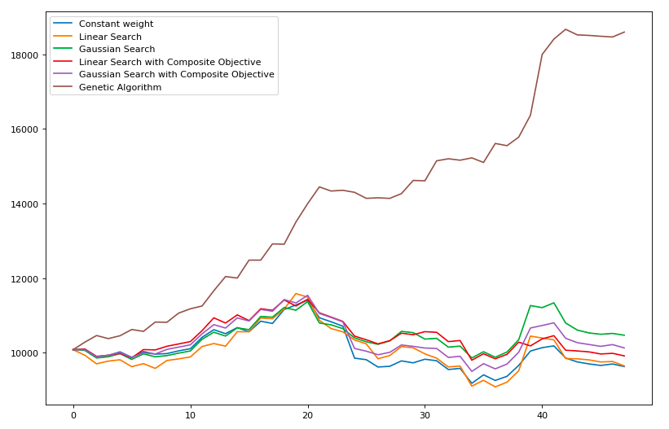

Slide 11
Methodology | Value at the end of 48 days (Objective 1) | Standard Deviation of returns (Objective 2)
Constant Weights | 9629.49 | 24.374
Linear Sampling | 9647.64 | 25.9
Gaussian Search | 10658.35 | 28.5464
Linear Search with composite objective | 9915.9 | 23.0786
Gaussian Search with composite objective | 10840.24 | 21.20
Genetic Mutation | 18371.14 | -

Slide 12
Case Study - 2
Portfolio optimisation for Algorithmic trading Financial markets are the source of a large amount of time series data. This data can be used to approximate an ideal portfolio (set of assets in possession) for any given day by using historical data.
We are using a dataset of 2 stocks of 48 days from the financial year of 2015. Everyday a constant fund of 10000 Rs is used which is divided by assigning weights to be invested into the stocks.
Different methods of assigning weights have been discussed.
Initially single objective was considered. Later on combination of two conflicting objectives has been studied.
In the future, we plan to use NSGA-II in place of addition of objectives. Along with that, a RL model will be implemented to learn to invest more efficiently whose weights will be trained by NSGA-II

Slide 13
Methods of assigning weights
Constant division of commodities/stocks: W1 = 0.5 and W2 = 0.5
Linear search of weights: 100 iterations from 0.00 to 1.00 for each of W1 and W2 Best of those 100 iterations per day are used as a starting point for next day.
Gaussian search : Gaussian noise is added to the weights. Search Space is reduced.
Linear search with composite objective: Scalar addition of two objective functions is used to perform.
Gaussian search with composite objective
Genetic Algorithm : Weights are selected by fitness scores and mutation is performed.

Slide 14
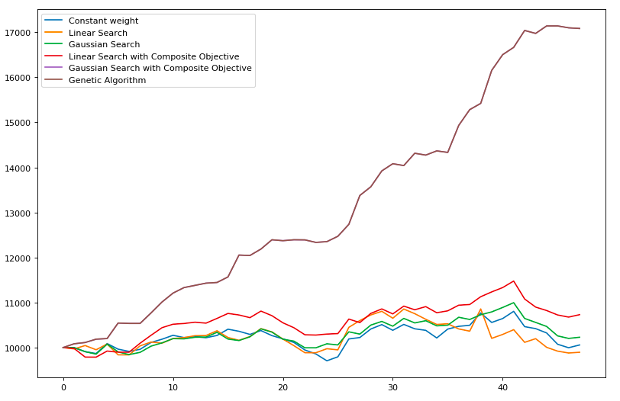

Slide 15
Methodology | Value at the end of 48 days (Objective 1) | Standard Deviation of returns (Objective 2)
Constant Weights | 10066.90 | 30.3266
Linear Sampling | 9905.35 | 54.9555
Gaussian Search | 10238.20 | 29.6524
Linear Search with composite objective | 10738.60 | 30.5035
Gaussian Search with composite objective | 10841.65 | 42.0988
Genetic Algorithm | 17078.85 | -

Slide 16
Conclusion
In both case studies optimisation of weights by genetic algorithms proves to be significantly better at maximising value.
Gaussian search out performs linear search by being both, faster and more accurate. Thus leading us to hypothesise that there are underlying patterns in the data which can be exploited.
Composite objective functions help both objectives individually by better guiding the algorithm through the search space.

Slide 17
Timeline
AUG
SEPT
TODAY
OCT
NOV
Presentation of -
Case Study 1
Single Objective
Composite Objective
Case Study 2
Single Objective
Composite Objective
Machine learning model has not been added yet.
Literature Review
Finding relevant datasets
Selecting the objective functions and variables
Formulating constraints
Data Cleaning
Implement NSGA-II by defining separate objectives.
Fit the data to a reinforcement learning model
Analyse the accuracy and make necessary refinements
Optimize the RL model by using NSGA-II
Analyse the Pareto Front and refine the algorithm
Generalise the algorithm to more industry data problems.
Data processing and reshaping
Single Objective
Scalar Addition of multiple objectives
Assigning weights to stocks -
Constant
Linear
Gaussian
Genetic Algo

Slide 18
Future Prospects
We plan to optimize the conflicting objectives simultaneously by implementing multi-objective genetic algorithm NSGA-II to obtain a Pareto Front between objectives.
Once that is done, our optimisation part is almost finished.
Then we will proceed to implement Reinforcement Learning Model which has proved to be very successful in time-series dataset.
The RL model will optimise and assign the stock weights based on some reward function and we would instead optimise the weights of the RL model using NSGA-II
Thus we will obtain a tradeoff between conflicting objectives.
Clustering of models as per the industry need can be done for taking decisions.

